Slide 1
Combinational Logic with MSI & LSI
Lectures14-16

Slide 2
4-bit Parallel Adder
Consider a circuit to add two 4-bit numbers together and a carry-in, to produce a 5-bit result:
5-bit result is sufficient because the largest result is:
(1111)₂+(1111)₂+(1)₂ = (11111)₂
X₄
X₃
X₂
X₁
Y₄
Y₃
Y₂
Y₁
4-bit
Parallel Adder
C₅
C₁
Black-box view of 4-bit parallel adder
S₄
S₃
S₂
S₁

Slide 3
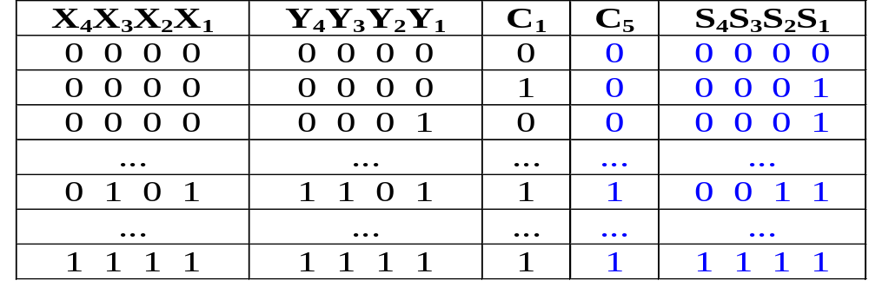
4-bit Parallel Adder
SSI design technique should not be used.
Truth table for 9 inputs very big, i.e. 2⁹=512 entries:
Simplification very complicated.

Slide 4
4-bit Parallel Adder
Alternative design possible.
Addition formulae for each pair of bits (with carry in),
C_{i+1}S_{i} = X_{i} + Y_{i} + C_{i}
has the same function as a full adder.
C_{i+1} = X_{i} .Y_{i} + (X_{i} ⊕ Y_{i} ) .C_{i}
S_{i} = X_{i} ⊕ Y_{i} ⊕ C_{i}

Slide 5
4-bit Parallel Adder
Cascading 4 full adders via their carries, we get:
Y₄ X₄
Y₃ X₃
Y₂ X₂
Y₁ X₁
C₄
C₃
C₂
C₅
FA
FA
FA
FA
C₁
S₄
S₃
S₂
S₁
Input
Output

Slide 6
Parallel Adders
Note that carry propagated by cascading the carry from one full adder to the next.
Called Parallel Adder because inputs are presented simultaneously (in parallel).

Slide 7
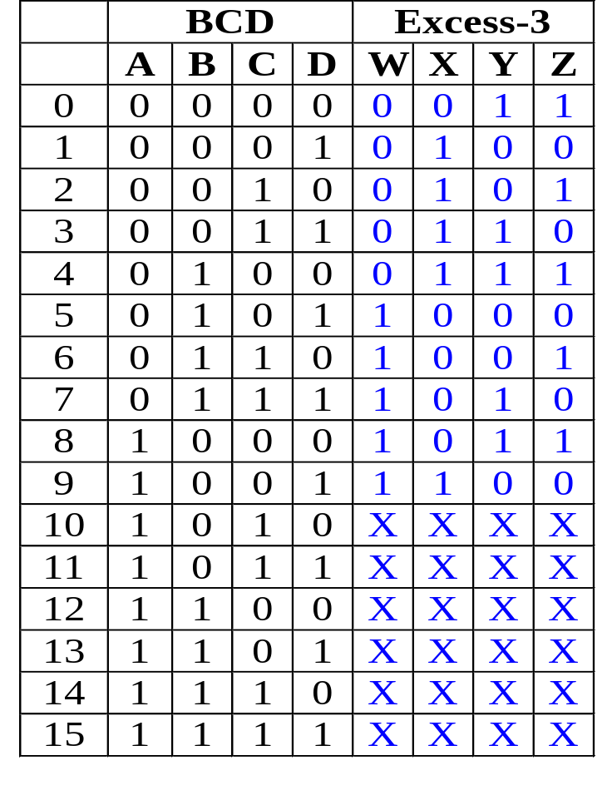
BCD-to-Excess-3 Code Converter
Excess-3 code can be converted from BCD code using truth table:
Gate Level Design can be used since only 4 inputs.
However, alternative design possible.
Use problem-specific formulae:
Excess-3 Code
= BCD Code + (0011)₂

Slide 8
BCD-to-Excess-3 Code Converter
Excess-3 Code = BCD Code + (0011)₂
Block-level circuit:
unused
X₄
X₃
X₂
X₁
Cout
BCD
code
S₄
S₃
S₂
S₁
4-bit Parallel Adder
Excess-3
code
0
0
1
1
Y₄
Y₃
Y₂
Y₁
A BCD-to-Excess-3 Code Converter
Cin
0

Slide 9
4-bit Parallel Adder cum Subtractor
Subtraction can be performed through addition using 2s-complement numbers.
Hence, we can design a circuit which can perform both addition and subtraction, using a parallel adder.
X₄
X₃
X₂
X₁
Y₄
Y₃
Y₂
Y₁
4-bit adder
cum subtractor
S: control signal for add/subtract
Result: either X+Y or X-Y

Slide 10
4-bit Parallel Adder cum Subtractor
The control signal S=0 means add
S=1 means subtract
Recall that:
X-Y = X + (-Y)
= X + (2’s complement of Y)
= X + (1’s complement of Y) +1
X+Y = X + (Y)

Slide 11
4-bit Parallel Adder cum Subtractor
Design requires:
  (i) XOR gates:
Y
Y
Y
Y'
S = 0
S = 1
such that: output = Y when S=0
= Y' when S=1
  (ii) S connected to carry-in.

Slide 12
4-bit Parallel Adder cum Subtractor
Adder cum subtractor circuit:
Y₄
Y₃
Y₂
Y₁
S
X₄
X₃
X₂
X₁
C
Cout
4-bit
parallel adder
Cin
Analysis:
If S=1, then
X + (1's complement of Y) +1
appears as the result.
If S=0, then X+Y appears as
the result.
S₄
S₃
S₂
S₁
A 4-bit adder cum subtractor

Slide 13
Calculation of Circuit Delays
In general, given a logic gate with delay, t.
If inputs are stable at times t₁,t₂,..,t_{n}, respectively; then the earliest time in which the output will be stable is:
max(t₁, t₂, .., t_{n}) + t
To calculate the delays of all outputs of a combinational circuit, repeat above rule for all gates.
t₁
t₂
Logic
Gate
:
:
t_{n}
max (t₁, t₂, ..., t_{n} ) + t

Slide 14
Calculation of Circuit Delays
As a simple example, consider the full adder circuit where all inputs are available at time 0. (Assume each gate has delay t.)
where outputs S and C, experience delays of 2t and 3t, respectively.
X
Y
0
max(0,0)+t = t
max(t,0)+t = 2t
0
S
t
2t
max(t,2t)+t = 3t
C
Z
0

Slide 15
Calculation of Circuit Delays
More complex example: 4-bits parallel adder.
Y₄ X₄
Y₃ X₃
Y₂ X₂
Y₁ X₁
C₄
C₃
C₂
0
0
0
0
0
0
0
0
0
C₅
FA
FA
FA
FA
C₁
S₄
S₃
S₂
S₁

Slide 16
Calculation of Circuit Delays
Analyze the delay for the repeated block:
Performing the delay calculation gives:
0
where X_{i}, Y_{i} are stable at 0t, while C_{i} is assumed to be stable at mt
X_{i}
Y_{i}
C_{i}
0
0
Full
Adder
S_{i}
C_{i+1}
mt
max(0,0)+t = t
max(t,mt)+t
0
S_{i}
t
max(t,mt)+t
max(t,mt)+2t
C_{i+1}
C_{i}
mt

Slide 17
Calculation of Circuit Delays
Calculating:
When i=1, m=0: S₁ = 2t and C₂ = 3t.
When i=2, m=3: S₂ = 4t and C₃ = 5t.
When i=3, m=5: S₃ = 6t and C₄ = 7t.
When i=4, m=7: S₄ = 8t and C₅ = 9t.
In general, an n-bit ripple-carry parallel adder will experience:
S_{n} = ((n-1)*2+2)t
C_{n+1} = ((n-1)*2+3)t
as their delay times.
Propagation delay of ripple-carry parallel adders is proportional to the number of bits it handles.
Maximum Delay: ((n-1)*2+3)t

Slide 18
Faster Circuits
Three ways of improving the speed of these circuits:
  (i) Use better technology (e.g. ECL faster than TTL gates), BUT
    (a) faster technology is more expensive, needs more power, lower-level of integrations.
    (b) physical limits (e.g. speed of light, size of atom).
  (ii) Use gate-level designs to two-level circuits! (use sum- of-products/product-of-sums) BUT
    (a) complicated designs for large circuits.
    (b) product/sum terms need MANY inputs!
  (iii) Use clever look-ahead techniques BUT there are additional costs (hopefully reasonable).

Slide 19
Look-Ahead Carry Adder
Consider the full adder:
The outputs, C_{i+1}, S_{i}, in terms of P_{i} ,G_{i} ,C_{i} , are:
S_{i} = P_{i} ⊕ C_{i} …(1)
C_{i+1} = G_{i} + P_{i}.C_{i} …(2)
If you look at equation (2),
G_{i} = X_{i}.Y_{i} is a carry generate signal
P_{i} = X_{i} ⊕ Y_{i} is a carry propagate signal
P_{i}
where intermediate signals are labelled as P_{i}, G_{i}, and defined as:
P_{i} = X_{i}⊕Y_{i}
G_{i} = X_{i}.Y_{i}
X_{i}
Y_{i}
S_{i}
G_{i}
C_{i+1}
C_{i}

Slide 20
Look-Ahead Carry Adder
For 4-bit ripple-carry adder, the equations to obtain four carry signals are:
C_{i+1} = G_{i} + P_{i}.C_{i}
C_{i+2} = G_{i+1} + P_{i+1}.C_{i+1}
C_{i+3} = G_{i+2} + P_{i+2}.C_{i+2}
C_{i+4} = G_{i+3} + P_{i+3}.C_{i+3}
C_{i}
P_{i}
These formula are deeply nested, as shown here for C_{i+2}:
C_{i+1}
G_{i}
P_{i+1}
C_{i+2}
G_{i+1}
4-level circuit for C_{i+2} = G_{i+1} + P_{i+1}.C_{i+1}

Slide 21
Look-Ahead Carry Adder
Nested formula/gates cause ripple-carry propagation delay.
Can reduce delay by expanding and flattening the formula for carries. For example, C_{i+2}
C_{i+2} = G_{i+1} + P_{i+1}.C_{i+1}
= G_{i+1} + P_{i+1}.(G_{i} + P_{i}.C_{i} )
= G_{i+1} + P_{i+1}.G_{i} + P_{i+1}.P_{i}.C_{i}
New faster circuit for C_{i+2}
C_{i}
P_{i}
P_{i+1}
G_{i}
C_{i+2}
P_{i+1}
G_{i+1}

Slide 22
Look-Ahead Carry Adder
Other carry signals can also be similarly flattened.
C_{i+3}= G_{i+2} + P_{i+2}C_{i+2}
= G_{i+2} + P_{i+2}(G_{i+1} + P_{i+1}G_{i} + P_{i+1}P_{i}C_{i})
= G_{i+2} + P_{i+2}G_{i+1} + P_{i+2}P_{i+1}G_{i} + P_{i+2}P_{i+1}P_{i}C_{i}
C_{i+4} = G_{i+3} + P_{i+3}C_{i+3}
= G_{i+3} + P_{i+3}(G_{i+2} + P_{i+2}G_{i+1} + P_{i+2}P_{i+1}G_{i} + P_{i+2}P_{i+1}P_{i}C_{i})
= G_{i+3} + P_{i+3}G_{i+2} + P_{i+3}P_{i+2}G_{i+1} + P_{i+3}P_{i+2}P_{i+1}G_{i} + P_{i+3}P_{i+2}P_{i+1}P_{i}C_{i}
Notice that formulae gets longer with higher carries.
Also, all carries are two-level “sum-of-products” expressions, in terms of the generate signals, Gs, the propagate signals, Ps, and the first carry-in, C_{i}.

Slide 23
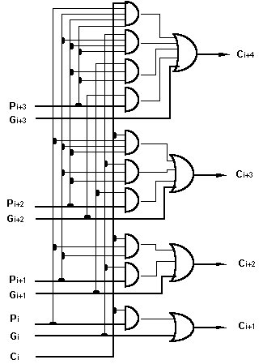
Look-Ahead Carry Adder
We employ the look-ahead formula in this lookahead-carry adder circuit:

Slide 24
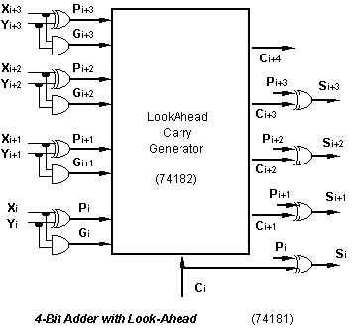
Look-Ahead Carry Adder
The 74182 IC chip allows faster lookahead adder to be built.
Maximum propagation delay is 4t (t to get generate & propagate signals, 2t to get the carries and t for the sum signals) where t is the average gate delay.

Slide 25
Useful MSI circuits
Four common and useful MSI circuits are:
  Decoder
  Demultiplexer
  Encoder
  Multiplexer
Block-level outlines of MSI circuits:
decoder
encoder
code
entity
entity
code
mux
data
data
demux
output
input
select
select

Slide 26
Decoders
Codes are frequently used to represent entities, e.g. your name is a code to denote yourself (an entity!).
These codes can be identified (or decoded) using a decoder. Given a code, identify the entity.
Convert binary information from n input lines to (max. of) 2^{n} output lines.
Known as n-to-m-line decoder, or simply n:m or n×m decoder (m ≤ 2^{n}).
May be used to generate 2^{n} (or fewer) minterms of n input variables.

Slide 27
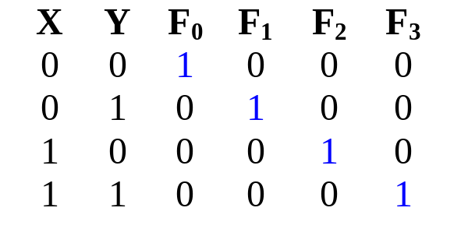
Decoders
Example: if codes 00, 01, 10, 11 are used to identify four light bulbs, we may use a 2-bit decoder:
2x4
Dec
F₀ F₁ F₂ F₃
Bulb 0
Bulb 1
Bulb 2
Bulb 3
2-bit code
X
Y
This is a 2×4 decoder which selects an output line based on the 2-bit code supplied.
Truth table:

Slide 28
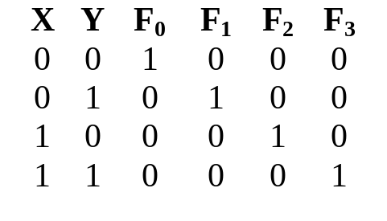
Decoders
From truth table, circuit for 2×4 decoder is:
Note: Each output is a 2-variable minterm (X'.Y', X'.Y, X.Y' or X.Y)
F₀ = X'.Y'
F₁ = X'.Y
F₂ = X.Y'
F₃ = X.Y
X
Y

Slide 29
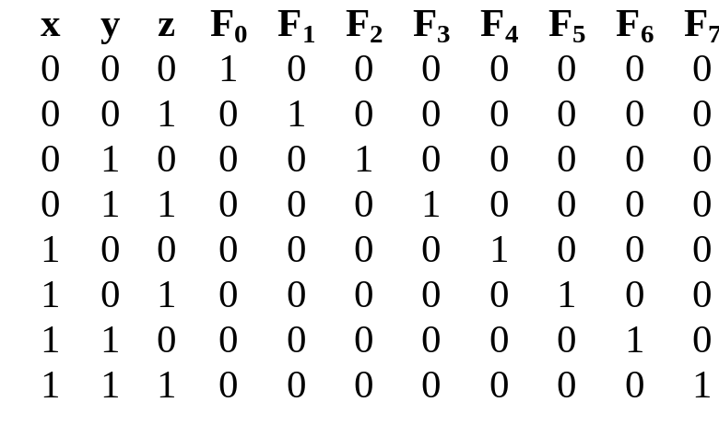
Decoders
Design a 3×8 decoder.
F₀ = x'.y'.z'
F₁ = x'.y'.z
F₂ = x'.y.z'
F₃ = x'.y.z
F₄ = x.y'.z'
F₅ = x.y'.z
Application? Binary-to-octal conversion.
F₆ = x.y.z'
F₇ = x.y.z
x
y
z

Slide 30
Decoders
In general, for an n-bit code, a decoder could select up to 2^{n} lines:
n-bit
code
n to 2^{n}
decoder
up to 2^{n}
output lines
:
:

Slide 31
Decoders: Implementing Functions
A Boolean function, in sum-of-minterms form  decoder to generate the minterms, and an OR gate to form the sum.
Any combinational circuit with n inputs and m outputs can be implemented with an n:2^{n} decoder with m OR gates.
Good when circuit has many outputs, and each function is expressed with few minterms.

Slide 32
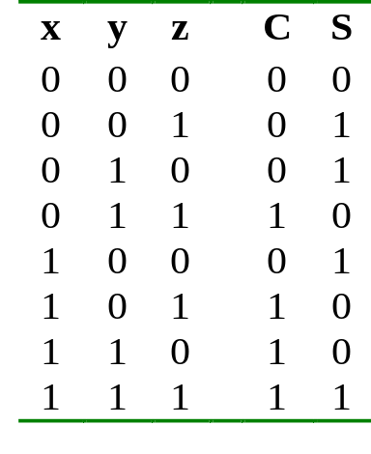
Decoders: Implementing Functions
Example: Full adder
  S(x, y, z) = Σ m(1,2,4,7)
  C(x, y, z) = Σ m(3,5,6,7)
3x8
Dec
0
1
2
3
4
5
6
7
S
x
S₂
S₁
S₀
y
z
C

Slide 33
Decoders: Implementing Functions
3x8
Dec
0
1
2
3
4
5
6
7
S
0
0
0
0
x
S₂
S₁
S₀
y
C
0
z

Slide 34
Decoders: Implementing Functions
3x8
Dec
0
1
2
3
4
5
6
7
S
1
1
1
1
x
S₂
S₁
S₀
y
C
1
z

Slide 35
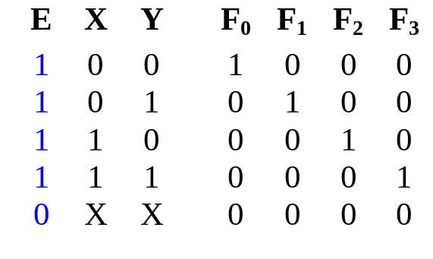
Decoders with Enable
Decoders often come with an enable signal, so that the device is only activated when the enable, E=1.
Truth table:
F₀ = EX'Y'
F₁ = EX'Y
F₂ = EXY'
F₃ = EXY
Circuit:
X
Y
E

Slide 36
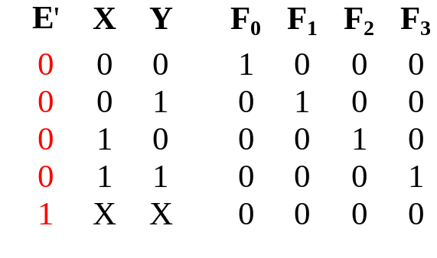
Decoders with Enable
In the previous slide, the decoder has a one-enable signal, that is, the decoder is enabled with E=1.
In most MSI decoders, enable signal is zero-enable, usually denoted by E’ (or E). The decoder is enabled when the signal is zero.
Decoder with 1-enable
Decoder with 0-enable

Slide 37
Larger Decoders
Larger decoders can be constructed from smaller ones.
For example, a 3-to-8 decoder can be constructed from two 2-to-4 decoders (with one-enable), as follows:
3x8
Dec
0
1
:
:
7
F₀ = w'x'y'
F₁ = w'x'y
:
:
F₇ = wxy
w
x
y
S₂
S₁
S₀
2x4
Dec
w
x
y
0
1
2
3
F₀ = w'x'y'
F₁ = w'x'y
F₂ = w'xy'
F₃ = w'xy
S₁
S₀
E
2x4
Dec
0
1
2
3
F₄ = wx'y'
F₅ = wx'y
F₆ = wxy'
F₇ = wxy
S₁
S₀
E

Slide 38
Larger Decoders
3x8
Dec
2x4
Dec
0
1
:
:
7
F₀ = w'x'y'
F₁ = w'x'y
:
:
F₇ = wxy
0
0
0
1
0
0
0
w
x
y
0
1
2
3
F₀ = w'x'y'
F₁ = w'x'y
F₂ = w'xy'
F₃ = w'xy
w
x
y
S₂
S₁
S₀
S₁
S₀
E
1= enabled
enabled
2x4
Dec
0
1
2
3
F₄ = wx'y'
F₅ = wx'y
F₆ = wxy'
F₇ = wxy
S₁
S₀
E
0 = disabled
0 = disabled

Slide 39
Larger Decoders
2x4
Dec
3x8
Dec
0
0
1
w
x
y
0
1
2
3
0
1
0
0
F₀ = w'x'y'
F₁ = w'x'y
F₂ = w'xy'
F₃ = w'xy
0
1
:
:
7
F₀ = w'x'y'
F₁ = w'x'y
:
:
F₇ = wxy
S₁
S₀
w
x
y
S₂
S₁
S₀
E
1= enabled
1 = enabled
2x4
Dec
0
0
0
0
0
1
2
3
F₄ = wx'y'
F₅ = wx'y
F₆ = wxy'
F₇ = wxy
S₁
S₀
E
0 = disabled
0 = disabled

Slide 40
Larger Decoders
1
1
0
2x4
Dec
0
0
0
0
3x8
Dec
w
x
y
0
1
2
3
F₀ = w'x'y'
F₁ = w'x'y
F₂ = w'xy'
F₃ = w'xy
0
1
:
:
7
F₀ = w'x'y'
F₁ = w'x'y
:
:
F₇ = wxy
S₁
S₀
w
x
y
S₂
S₁
S₀
E
0 = disabled
0 = disabled
2x4
Dec
0
1
2
3
F₄ = wx'y'
F₅ = wx'y
F₆ = wxy'
F₇ = wxy
S₁
S₀
E
1 = enabled
1= enabled

Slide 41
Larger Decoders
Construct a 4x16 decoder from two 3x8 decoders with 1-enable.
4x16
Dec
w
x
y
z
S₃
S₂
S₁
S₀
0
1
:
:
15
F₀
F₁
:
:
F₁₅
3x8
Dec
w
x
y
z
0
1
:
7
F₀
F₁
:
F₇
S₂
S₁
S₀
E
3x8
Dec
S₂
S₁
S₀
0
1
:
7
F₈
F₉
:
F₁₅
E

Slide 42
Larger Decoders
Note: The input, w and its complement, w', is used to select either one of the two smaller decoders.
Decoders may also have zero-enable and/or negated outputs. (Normal outputs = active high; negated outputs = active low.)
Exercise: What modifications must be made to provide an ENABLE input for the 3x8 decoder (2 slides ago) and the 4x16 decoder (previous slide) created?
Exercise: How to construct a 4x16 decoder using five 2x4 decoders with enable?

Slide 43
Decoders: Implementing Functions (2)
Example: Implement the following logic function using decoders and logic gates
f(Q,X,P) = ∑ m(0,1,4,6,7) = ∏ M(2,3,5)
We may implement the function in several ways:
  Use a decoder (with active-high outputs) with an OR gate:
  f(Q,X,P) = m₀ + m₁ + m₄ + m₆ + m₇
  Use a decoder (with active-low outputs) with a NAND gate:
  f(Q,X,P) = ( m₀' . m₁' . m₄' . m₆' . m₇' )'
  Use a decoder (with active-high outputs) with a NOR gate:
  f(Q,X,P) = ( m₂ + m₃ + m₅ )' [ = M₂.M₃.M₅]
  Use a decoder (with active-low outputs) with an AND gate:
  f(Q,X,P) = m₂' . m₃' . m₅'

Slide 44
w
w
y
y
0
0
0
0
w
w
y
y
1
1
1
1
y
y
2
2
En
y
y
3
3
w
y
y
0
0
4
w
y
y
1
1
5
y
y
w
2
6
2
w
y
En
y
y
0
0
3
7
w
w
y
3
1
1
y
2
w₀
En
En
y
w
y
y
3
0
8
w
y
y
1
1
9
y
y
2
10
En
y
y
3
11
w
y
y
0
0
12
w
y
y
1
1
13
y
y
2
14
En
y
y
3
15
Figure 6.18. A 4-to-16 decoder built using a decoder tree.

Slide 45
w
0
w
1
s
0
w
y
0
0
s
1
w
y
f
1
1
y
2
w
2
1
En
y
3
w
3
Figure 6.19. A 4-to-1 multiplexer built using a decoder.

Slide 46
Multiplexer
A multiplexer is a device which has
(i) a number of input lines
(ii) a number of selection lines
(iii) one output line
It steers one of 2^{n} inputs to a single output line, using n selection lines. Also known as a data selector.
2^{n}:1
Multiplexer
inputs
output
...
select

Slide 47
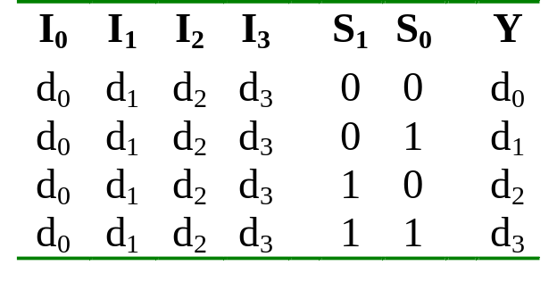
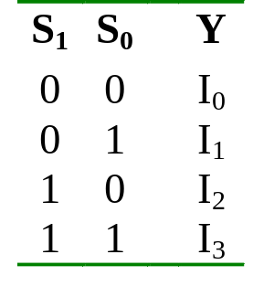
Multiplexer
Truth table for a 4-to-1 multiplexer:
Inputs
Inputs
I₀
0
1
2
3
I₀
I₁
4:1
MUX
I₁
I₂
Y
Output
I₂
mux
Y
I₃
I₃
S₁ S₀
S₁ S₀
select
select

Slide 48
Multiplexer
Output of multiplexer is
“sum of the (product of data lines and selection lines)”
Example: the output of a 4-to-1 multiplexer is:
Y = I₀.(S₁’.S₀') + I₁.(S₁’.S₀) + I₂.(S₁.S₀') + I₃.(S₁.S₀)
A 2^{n}-to-1-line multiplexer, or simply 2^{n}:1 MUX, is made from an n: 2^{n} decoder by adding to it 2^{n} input lines, one to each AND gate.

Slide 49
Multiplexer
I₀
I₁
Y
I₂
I₃
S₁
S₀

Slide 50
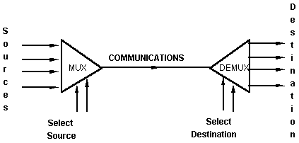
Multiplexer
An application:
Helps share a single communication line among a number of devices.
At any time, only one source and one destination can use the communication line.

Slide 51
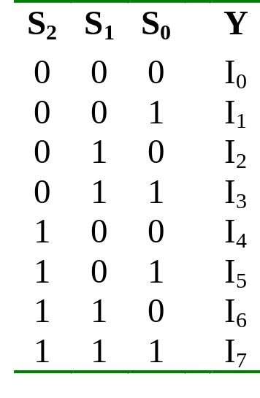
Larger Multiplexers
Larger multiplexers can be constructed from smaller ones.
An 8-to-1 multiplexer can be constructed from smaller multiplexers like this (note placement of selector lines):
I₀
I₁
I₂
I₃
4:1 MUX
2:1 MUX
S₁ S₀
Y
I₄
I₅
I₆
I₇
4:1 MUX
S₂
S₁ S₀

Slide 52
Larger Multiplexers
I₀
I₁
I₂
I₃
When
S₂S₁S₀ = 000
I₀
4:1 MUX
2:1 MUX
I₀
S₁ S₀
Y
I₄
I₅
I₆
I₇
4:1 MUX
I₄
S₂
S₁ S₀

Slide 53
Larger Multiplexers
When
S₂S₁S₀ = 110
I₀
I₁
I₂
I₃
I₂
4:1 MUX
2:1 MUX
I₆
S₁ S₀
Y
I₄
I₅
I₆
I₇
4:1 MUX
I₆
S₂
S₁ S₀

Slide 54
Larger Multiplexers
Another implementation of an 8-to-1 multiplexer using smaller multiplexers:
When
S₂S₁S₀ = 000
I₀
I₁
2:1 MUX
I₀
I₂
I₃
2:1 MUX
I₂
S₀
4:1 MUX
I₀
S₀
I₄
I₅
2:1 MUX
I₄
S₂ S₁
S₀
I₆
I₇
2:1 MUX
I₆
S₀

Slide 55
Larger Multiplexers
When
S₂S₁S₀ = 001
I₀
I₁
I₂
I₃
4:1 MUX
2:1 MUX
S₁ S₀
Y
I₄
I₅
I₆
I₇
4:1 MUX
S₂
S₁ S₀

Slide 56
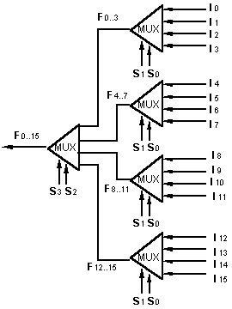
Larger Multiplexers
A 16-to-1 multiplexer can be constructed from five 4-to-1 multiplexers:

Slide 57
Multiplexers: Implementing Functions
F(A,B,C) = Σ m(1,3,5,6)
0
1
0
1
0
1
1
0
0
1
2
3
4
5
6
7
This method works because:
Output = m₀.I₀ + m₁.I₁ + m₂.I₂ + m₃.I₃ + m₄.I₄ + m₅.I₅ + m₆.I₆ + m₇.I₇
Supplying ‘1’ to I₁,I₃,I₅,I₆ , and ‘0’ to the rest:
Output = m₁ + m₃ + m₅ + m₆
F
mux
A B C

Slide 58
Multiplexers: Implementing Functions
A Boolean function can be implemented using multiplexers.
A 2^{n}-to-1 multiplexer can implement a Boolean function of n input variables, as follows:
  (i) Express in sum-of-minterms form.
Example: F(A,B,C) = A'B'C + A'BC + AB'C + ABC'
= Σ m(1,3,5,6)
  (ii) Connect n variables to the n selection lines.
  (iii) Put a '1' on a data line if it is a minterm of the function, '0' otherwise.

Slide 59
Multiplexers: Implementing Functions
F(A,B,C) = Σ m(1,3,5,6)
0
1
0
1
0
1
1
0
0
1
2
3
4
5
6
7
This method works because:
Output = m₀.I₀ + m₁.I₁ + m₂.I₂ + m₃.I₃ + m₄.I₄ + m₅.I₅ + m₆.I₆ + m₇.I₇
Supplying ‘1’ to I₁,I₃,I₅,I₆ , and ‘0’ to the rest:
Output = m₁ + m₃ + m₅ + m₆
F
mux
A B C

Slide 60
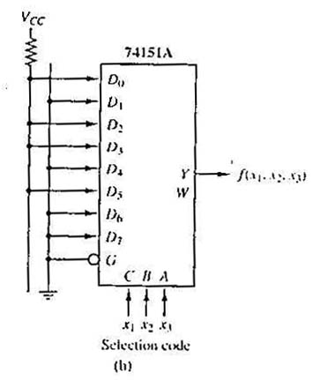
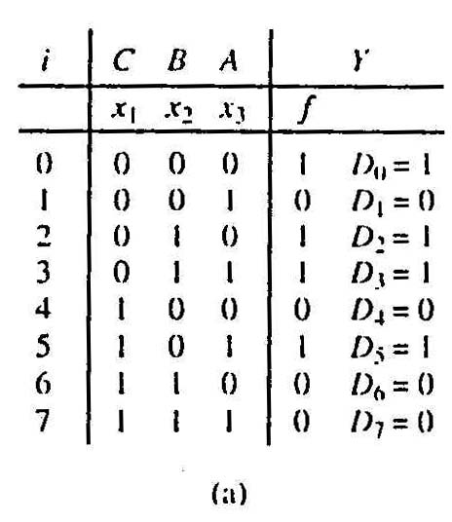
Multiplexers: Implementing Functions
Example: Use a 74151A to implement:
f(x₁,x₂,x₃) = ∑ m(0,2,3,5)
Realization of f(x₁,x₂,x₃) = ∑m(0,2,3,5).
(a)Truth table.
(b)Implementation with 74151A.

Slide 61
Using Smaller Multiplexers
Earlier, we saw how a 2^{n}-to-1 multiplexer can be used to implement any Boolean function of n (input) variables.
However, we can use a single smaller 2^{(n-1)}-to-1 multiplexer to implement any Boolean function of n (input) variables.
In particular, the earlier function
F(A,B,C) = ∑ m(1,3,5,6)
can be implemented using a 4-to-1 multiplexer (rather than an 8-to-1 multiplexer).

Slide 62
Using Smaller Multiplexers
Let’s look at this example:
F(A,B,C) = Σ m(0,1,3,6) = A’B’C’ + A’B’C + A’BC + ABC’
A’B’
1
1
0
1
0
0
1
0
0
1
2
3
4
5
6
7
1
C
0
C'
0
1
2
3
F
mux
F
mux
A B C
A B
Note: Two of the variables, A, B, are applied as selection lines of the multiplexer, while the inputs of the multiplexer contain 1, C, 0 and C'.

Slide 63
Using Smaller Multiplexers
Procedure
  1) Express boolean function in “sum-of-minterms” form.
  e.g. F(A,B,C)= Σ m(0,1,3,6)
  2) Reserve one variable (in our example, we take the least significant one) for input lines of multiplexer, and use the rest for selection lines.
  e.g. C is for input lines, A and B for selection lines.

Slide 64
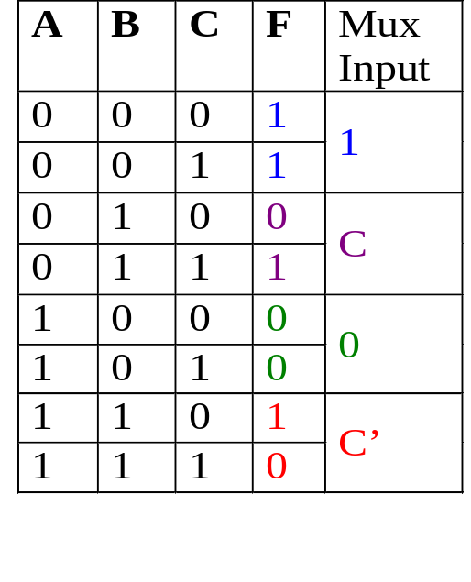
Using Smaller Multiplexers
  3) Draw the truth table for function, but grouping inputs by selection line values, and then determine multiplexer inputs by comparing input line (C) and function (F) for corresponding selection line values.
1
0
0
1
2
3
C
F
mux
A B

Slide 65
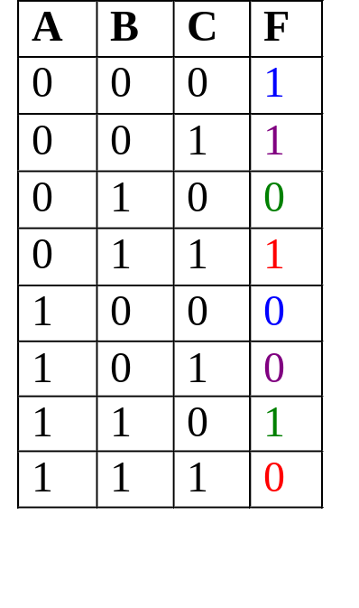
Using Smaller Multiplexers
Alternative: What if we use A for input lines, and B, C for selector lines?
A’ (when BC = 00)
A’ (when BC = 01)
A (when BC = 10)
A
0
1
2
3
F
A’ (when BC = 11)
mux
B C

Slide 66
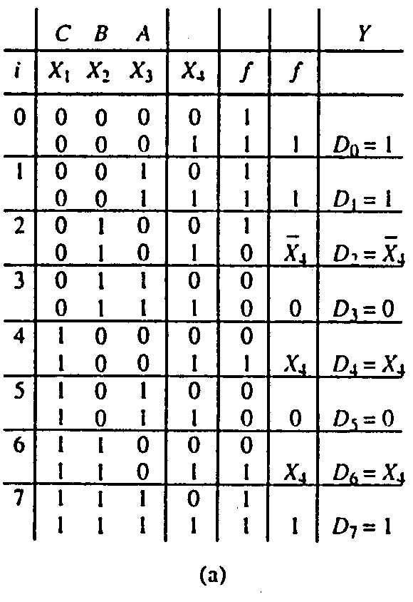
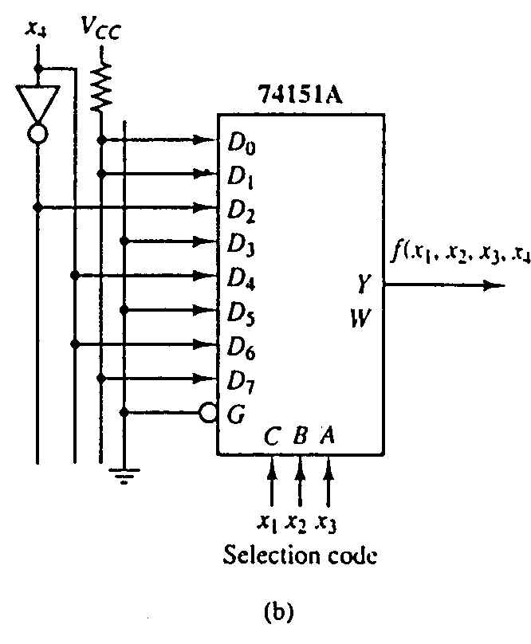
Using Smaller Multiplexers
Example: Implement using a 74151A the function:
f(x₁,x₂,x₃,x₄) = ∑ m(0,1,2,3,4,9,13,14,15)

Slide 67
Implement the Boolean function by using 8x1 MUX –
F(A,B,C,D)=∑m(0,1,3,4,8,9,14,15)
Total number of variables , n= 4 (A,B,C,D)
Select line variable (n-1) = 3 (B,C,D) Input variable = 1 (A)
Implementation table –
 | I0 | I1 | I2 | I3 | I4 | I5 | I6 | I7
(A’)0 | 0 | 1 | 2 | 3 | 4 | 5 | 6 | 7
(A)1 | 8 | 9 | 10 | 11 | 12 | 13 | 14 | 15
 | 1 | 1 | 0 | A’ | A’ | 0 | A | A

Slide 68
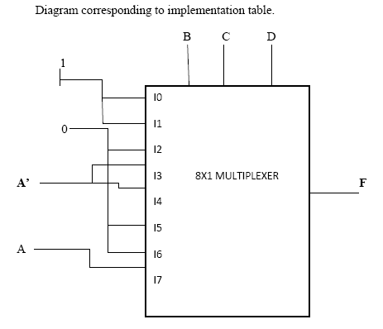

Slide 69

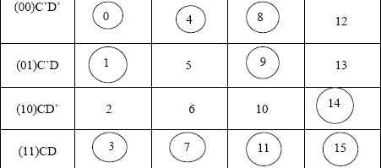
Implement the following function using 4x1 MUX- F(A,B,C,D)=∑m(0,1,3,4,7,8,9,11,14,15)

Slide 70
Solving minterms corresponding to I0-
I0→ C’D’+C’D+CD
=C’(D’+D)+CD
=C’+CD
=C’+D
Solving minterms corresponding to I1-
I1→ C’D’+CD = C (X-NOR) D
Solving minterms corresponding to I2-
I2→ C’D’+C’D+C = C’+D
Solving minterms corresponding to I3-
I3→ CD’+CD = C

Slide 71
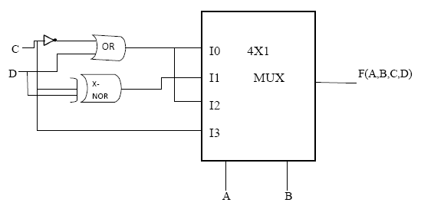

Slide 72
End of file

